Slide 1
Overcharging in the market for dental procedures
Team: Golden dentists

Slide 2
Problem:
Lack of price transparency
Affordability affects engagement

Slide 3
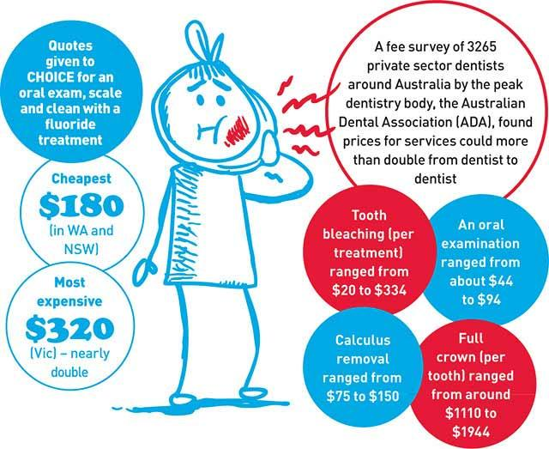

Slide 4
Dentists are unwilling to publish prices
User reviews don’t work

Slide 5
The solution:
Open sharing of dental procedure costs using verified receipts.

Slide 6
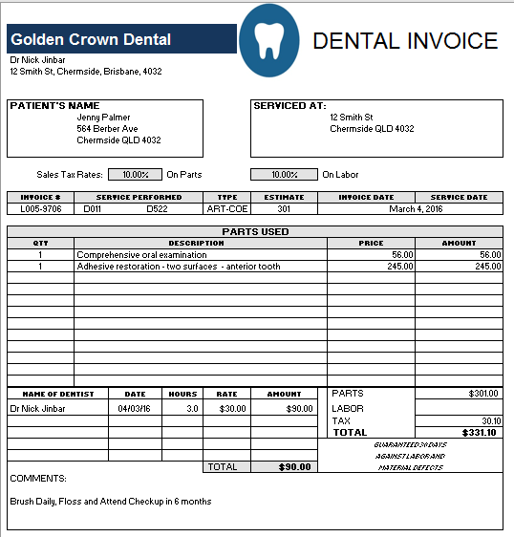

Slide 7
Use case:
I have been to the dentist. Have I been overcharged?

Slide 8
Open pricing leads to a healthy market.
Dutch case: more quality competition

Slide 9
Future:
Seeking grants/collaborations
Application to other markets: Medical services, mechanics, lawyers.

Slide 10
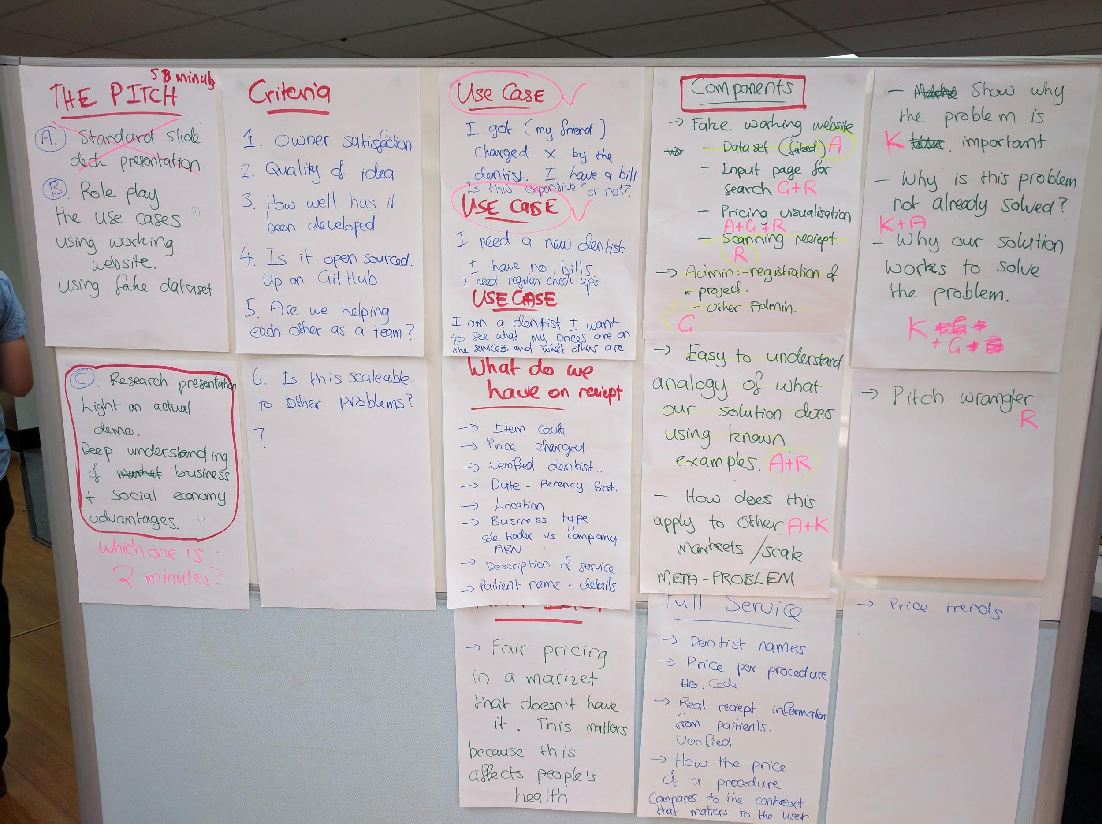

Slide 11
If you need a crown get gold.
Golden dentists

